Slide 1
Quebec City Cultural Trip Wednesday June 13th – Saturday, June 16th 2018
Parent Information Meeting
23 November, 2017.

Slide 2
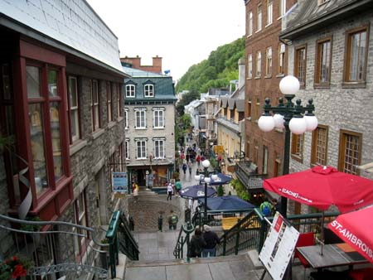
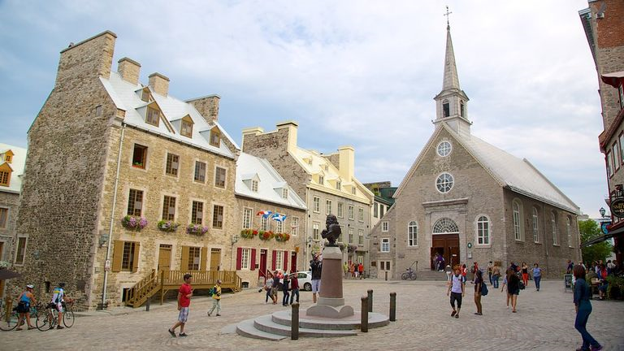
Key Activities
Pre-European Period (pre-1608)
French Period (1608 – 1763)
British Period (1763 – 1867)
Guided Walking Tour of Old Quebec Lower Town – Le Cartier Petit Champlain
Place Royal – birthplace of New France
Upper Town – Chateau Frontenac
Plaines of Abraham

Slide 3
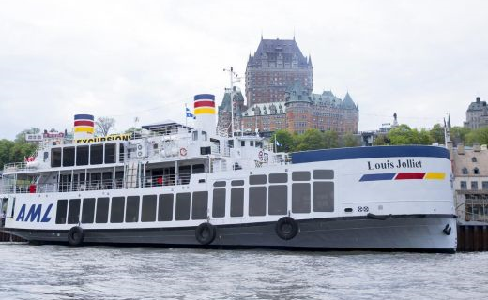
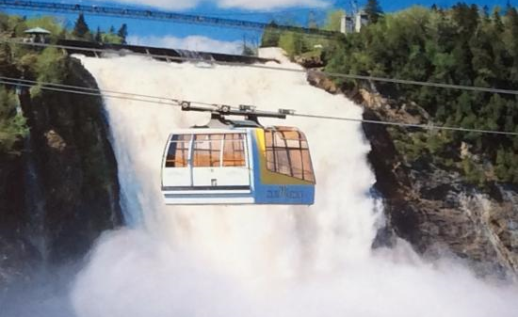
Key Activities (continued)
Quebec and Region
Legislature Building & Grounds
River Dance Cruise
Aquarium
Montmorency Falls
Quebec City Observatory
French Practice
Free Time in Old Quebec and
at the Galeries de la Capitale
Guided Tours
Improvisation Activity

Slide 4
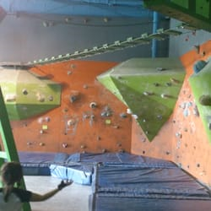
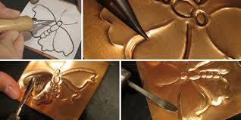
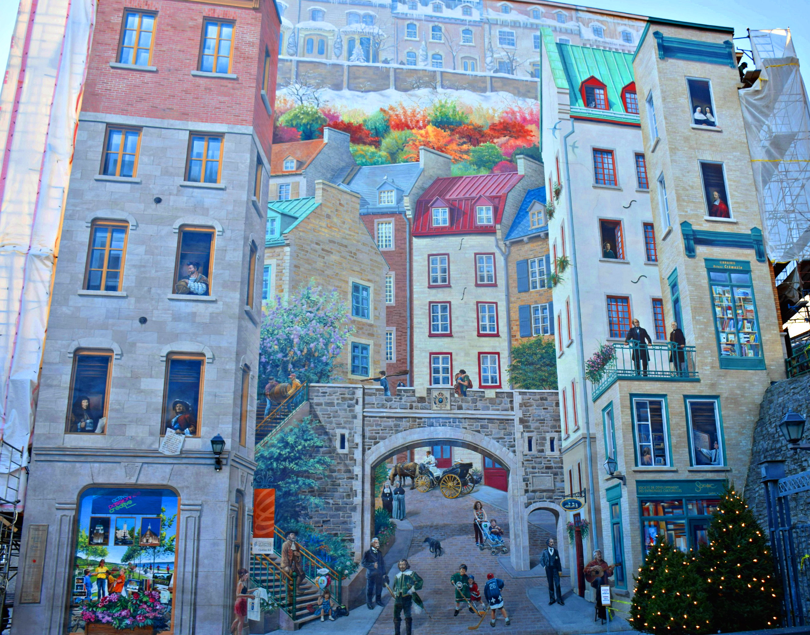
Key Activities (continued)
Sports and Arts
Lots of walking & dancing
Roc Gym – climbing centre
Copper Museum – learn about and try embossed copper art
Circus School
Murals

Slide 5
Itinerary
Wed PM | Wed Evening | Thurs AM | Thurs PM | Thurs Evening | Fri Am | Fri PM | Fri Evening | Sat AM
Aquarium | Tomas Tam’s buffet Dance Cruise | Old Quebec Walking tour: Le Quartier Petit Champlain; Place Royale; Chateau Frontenac; etc. | Legislature, Observatory & Improv (divided groups) | Maison du Spaghetti & Circus School | Copper Museum, Ste. Anne Basilica and Montmorency Falls (divided groups) | Copper Museum, Ste. Anne Basilica and Montmorency Falls (divided groups) | Galleries de la Capitale Cabane à Sucre | Roc Gym

Slide 6
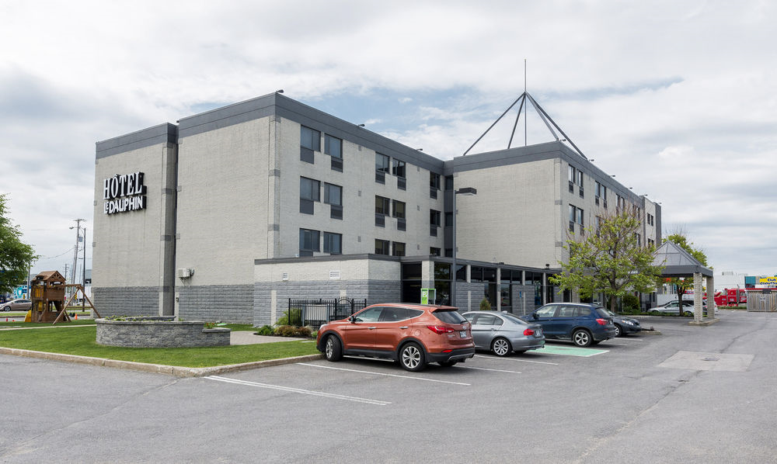
Accommodations
Hotel Dauphin (3-star)
2 queen beds in each room
Hot & Cold Buffet Breakfast
10-20 minute drive to all activities
Night security in the halls from
10:30 pm – 4:00 am
4 students per room,
2 chaperones per room

Slide 7
Meals
Included
Breakfast at Hotel (3)
All-you-can-eat buffet suppers (3)
Tomas Tam’s (Buffet)
Vieille Maison du Spaghetti (Italien – Grande Allée)
Érablière du Lac Beauport (Sugar Shack)
Excluded
4 x Lunch / 1 x Supper (plan for $10-12 each)

Slide 8
Show your Cougar PRIDE
 | Class | Common Areas | Community
P Prepared | I am prepared when I … - have my supplies (books, pen/pencil, etc.). - arrive on time. - attend all classes. | I am prepared when I … - have my supplies (lunch, money, clothing, etc.). - have a plan/destination. - arrive on time. | I am prepared when I … - have my supplies (equipment, clothing, etc.). - arrive on time.
R Respect | I show respect when I … - exercise kindness. - follow classroom procedures. - use materials properly. | I show respect when I … - exercise kindness. - leave an area cleaner than the way I found it. - follow procedures (hands to self, feet to self, line up, etc.). | I show respect when I … - exercise kindness. - use positive words and actions. - use appropriate volume/tone/language.
I Involved | I am involved when I … - participate and listen actively. - share ideas. - am a valuable team member. | I am involved when I … - speak up. - support school events. - join in. | I am involved when I … - help others. - am a role model. - volunteer.
D Determined | I show determination when I … - persevere. - seek / accept assistance. - set goals. | I show determination when I … - use time wisely. - interact with purpose. | I show determination when I … - work with others. - make a positive difference.
E Effort | I display effort when I … - give 100% and produce quality work. - accept a challenge. - know attendance matters. | I display effort when I … - own my actions. - encourage others. - problem solve. | I display effort when I … - support community needs. - represent the school with PRIDE at all times.

Slide 9
Chaperones
Ratio of 1:10 (free trip)
Present and past staff members
Local Tour Directors will join the group in Quebec City – available 24/7
Coordinates the tour
Animates and explains
Ensures that the kids have fun and learn
Is the main support for the chaperones
Troubleshoots any problems
Does not discipline

Slide 10
Payment Schedule
December 8th – Non-refundable deposit due to the school ($175.00)
Following the deposit, an online invoice will be sent directly to parents and will be payable directly to Bon Vivant Tours.
Payment Options: e-Transfer or Credit card
Balance due in 3 equal payments:
End of January
End of February
End of March
Option for additional cancellation insurance (contact Bon Vivant for more information).

Slide 11
Fundraising
The school will not be organizing any fundraisers however…
Option for students to participate in fundraising activities
Organized by parent volunteers
Organized by student(s)

Slide 12
What to bring
One suitcase + one carry-on bag
Students may wish to bring a pillow and blanket for the bus ride
Medication (prescription and non-prescription must be identified to chaperone).
Clothing:
Comfortable shoes for walking
Light jacket / hoodie for evenings (rain jacket or umbrella depending on weather)
At least one ‘dressy’ outfit for dinner / cruise evening
Toiletries and sunscreen
Sunglasses / hat
PE clothing (incl sneakers) for Roc Gym

Slide 13
How much spending money is needed?
Breakfast and supper (except Saturday) are included.
Students are responsible for:
Four lunches
One Supper (Saturday on the ride home)
Idea: Debit Card – set up well in advance of the trip.
Purchase gift cards (Tim Hortons/McDonalds) before leaving.
Spending money will depend on your child’s spending habits.

Slide 14
Electronic devices
Students are responsible for any electronic device they bring (phone, camera, tablet, etc.)
Know your phone plan (e.g. roaming charges).
Internet available in rooms.
The bus has Wi-Fi, however, with the number of students on the bus, this can be ‘spotty’.
Cell phone use may be restricted during certain portions of the intinerary (i.e museum, improve, citadel, etc.)

Slide 15
Questions?
Please contact the school at 847-6210 or email shawna.spinks@nbed.nb.ca or
jeff.nelson@nbed.nb.ca for more information.

